Slide 1


Excel in Corporate World with Microsoft Excel

Slide 2

Table of Contents
Overview of Topics Covered
Navigating through Excel – Exploring Menu bar and Tool bar functions
  Formatting Cells and Paste Special Option
  Sorting and Filtering Data
  Grouping and Subtotals
  Text to Columns and Extracting Unique Values
Types of Functions
  Text
  Statistical and Mathematical Functions
  Logical
  Look up and Reference
  Date and Time
  Information
What-If Analysis and Data Validation
Types of Charts and Formats
Pivot Tables and Reports
Macros and VBA
ActiveX Controls

Slide 3
Microsoft Excel is a spreadsheet application used to
  To manage the data stored in rows and columns like sort , store etc.,
  Perform various functions using text, mathematical, statistical, financial functions
  Data analysis using statistical functions for data based decisions. (analytics)
  Create summary tables called pivot tables and quick enquiries using filter options
  Create user forms and automate routine data analysis using VBA programming
2007 is enhanced with ribbons, aesthetic options, enhanced data capability handling and improved overall performance.

Slide 4
Entering Text and Numbers
The Microsoft Excel Window
The Microsoft Office Button
The Quick Access Toolbar
The Title Bar
Ribbon
Worksheets
The Formula Bar
The Status Bar
Move Around a Worksheet
Go To Cells Quickly
Select Cells
Enter Data
Edit a Cell
Wrap Text
Delete a Cell Entry
Save a File
Close Excel

Slide 5
Formulas and Formatting Data
Set the Enter Key Direction
Perform Mathematical Calculations
AutoSum
Perform Automatic Calculations
Align Cell Entries
Perform Advanced Mathematical Calculations
Copy, Cut, Paste, and Cell Addressing
Insert and Delete Columns and Rows
Create Borders
Merge and Center
Add Background Color
Change the Font, Font Size, and Font Color
Move to a New Worksheet
Bold, Italicize, and Underline
Work with Long Text
Change a Column's Width
Format Numbers

Slide 6
Excel Functions, filling Cells and Printing
Using Reference Operators
Understanding Functions
Fill Cells Automatically
Create Headers and Footers
Set Print Options
Print

Slide 7
Excel Functions, filling Cells and Printing - Creating Graphs & Pivot Tables
Using Reference Operators
Understanding Functions
Fill Cells Automatically
Create Headers and Footers
Set Print Options
Print
Graphs
Create a Chart
Apply A Chart Layout
Add Labels
Switch Data
Change the Style of a Chart
Change the Size and Position of a Chart
Move A Chart to a Chart Sheet
Change the Chart Type

Slide 8

First encounter
Office button
  File operations
  Printing
  Publishing
  Recent documents and button to pin these documents to recent documents of windows
  What do you observe after right click office button
Quick access tool bar
  What do you observe after right click of quick access tool bar
Excel Options
  Popular - Change most popular options
  Formula - Change options for formula calculating, performance and error handling
  Proofing – change how excel corrects and formats your text
  Save – change how workbooks are saved . Saving format, auto recover etc.,
  Advanced – change editing options, cut copy and paste options , display options, Lotus compatibility options
  Customize – Quick access tool bar
  Add-Ins – view and Manage Office add-ins
  Trust Center – for security and protection , windows security updates
  Resources – for other MS links and to run office diagnostics

Slide 9
First encounter - Warmup
Work Area
  Name Box
  Insert function box
  Formula Bar - Expand or collapse
  Column Headers
  Row Headers
  Cells and addressing the cells , Navigation of Cells
Scroll Bars, Split
Sheet tabs
Status Bar
  Ready Mode
  Enter Mode
  Quick Macro button
  Totals Display
Quick view buttons
Zoom and Zoom level Dialog Box
Excel file operations like New, open, save , save as and so on.

Slide 10
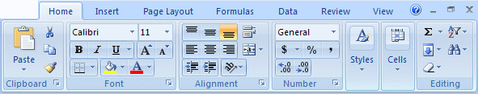
First encounter – Jump Start
Data Entry
Ribbon
  Right click ribbon area what do you observe
  Press ALT key what do you observe
  Position your cursor on Ribbon and roll the mouse wheel what do you observe
  Each tab has different ribbon and each ribbon is delimited by visible borders with a bottom title ex.Font in home tab
  Some sections have display button, if you click dialog box is open , can you open another dialog box of other section ?
  Position your cursor on a button for a while and what do you observe
  You can add buttons to quick access tool bar by right click . For some buttons, you can get context sensitive help.
  Resize the window and observe how the Ribbon is getting modified ?

Slide 11
First encounter – Jump Start into worksheets and workbooks
WorkSheets
  Select multiple worksheets and use pageup, pagedown, Alternatively use sheet navigation arrows
  Each worksheet is identified by names, you can change by double click on sheet or right click
  Showing gridlines of worksheet from pagelayout sheet options, view show/hide , experiment with checkbox headings also
  Change the view of the worksheet in normal, pagebreak mode, page layout
  You can change the order of the worksheets, hide/unhide, delete, protect the sheets
Workbooks
  You can create new workbooks from various templates available
  Open multiple workbooks and switch between them from View , show them in different ways . Excel supports multiple document interface (MDI)
Using Sorting and Filtering
  Open Credit bank file
  Sort on Credit card product
  Use filter to show only Gold and City Bangalore
  Remove Filter
  Create Subtotal based on credit card product on column Limit
Data Import from Text File
Number, Text, Date format change

Slide 12
Excel Short Cut Keys
Moving Through a Worksheet
Short cut Key | Description
Arrow Keys | Moves left, right, up or down one cell
Home | Move to the beginning of the row
End | Moves to the Lower-left cell displayed in the windows
PgUp | Moves up one screen
PgDn | Moves down one screen
ctrl+PgUp | Move to the previous sheet
ctrl+PgDn | Move to the next sheet
alt+pgUp | Move one screen to the left
alt+pgDn | Move one screen to the Right
Ctrl+Home | Move to the first cell in the sheet (a1)
Ctrl+End | Moves to the last active cell of the worksheet
Ctrl+Arrow Key | Moves to the edge of a data Block;if the cell is blank , moves to the first nonblank cell
Ctrl + Backspace | scrolls to display the active cell
shift + f6 | Moves to the previous pane of a window that has been split
ctrl+tab | Moves to the Next window
Ctrl+shift+tab | Moves to the Previous window
Key board Contains
  AlphaNumeric + Special Symbols, Control Keys like ESC, Enter, Backspace, Delete, Function Keys, Tab, etc.,
  Shift key,
  Tab key
  Back Space Key
  ALT key

Slide 13
Excel Short Cut Keys
Short cut Key | Description
Ctrl+A | Select whole sheet
Ctrl + C | copies the selected Range
Ctrl + X | cuts the selected Range
Ctrl + V | it paste the copied Range
F1 | display Help
Shift + F11 | Insert a new Work Sheet
F2 | Edit the active cell
Alt + F2 | Save As
Ctrl + S | Save
F 4 | Repeats the Last Action, convert to absolute value for cell address
F 5 | Go To
Shift + F5 | Displays the Find Dialog Box
F 7 | Spelling
ALT+=(equal sign) | Insert the AutoSum Formula
Ctrl+; (Semicolon) | Insert the Current Date
Ctrl+: (Colon) | Insert the Current Time
Ctrl+K | Insert a Hyperlink
Ctrl+Y | Redo the previous task
Ctrl+Home | Goes to beginning of the Sheet
Alt+Space Bar | Minimize (or) Maximize (or) Close
Ctrl+Down Arrow | Move to the End of the Column
Ctrl+Right Arrow | Move to the End of the Row
Ctrl+Space Bar | Select the Column
Shift+Space Bar | Select the Row

Slide 14
Excel Short Cut Keys
Short cut Key | Description
Ctrl+ + (Plus) | Insert Cell
Ctrl+ - (Minus) | Delete Cell
Ctrl+Shift+$ | Apply the Currency format
Ctrl+Shift+~ | Apply the General format
Ctrl+Shift+% | Apply the Percentage format
Ctrl+Shift+! | Apply the Number format with decimal places, 1000 separator
Ctrl+Shift+& | Apply the outline border
Ctrl+Shift+_ | Remove all Borders
Ctrl+9 | Hide Rows
Ctrl+Shift+( | Unhide Rows
Ctrl+0 (zero) | Hide columns
Ctrl+Shift+) | Unhide columns
Ctrl+Shift+* | Select the entire range of cell you're working on, but not the empty cells around the list.
Ctrl+1 | Display Format Cells dialog box
Ctrl+TAB | Move between open Work books
Ctrl+PgUp/PgDn | Move between the worksheets
Ctrl+End | Move to the End of the Sheet.
Ctrl+Shift+End | Block the Whole sheet.
Alt + Down Arrow | To select from the Drop List During Filter

Slide 15
Analyze Maharashtra State Census Data
&
Credit Banking data
Available in Excel Case Study
Explore Menu Ribbons

Slide 16
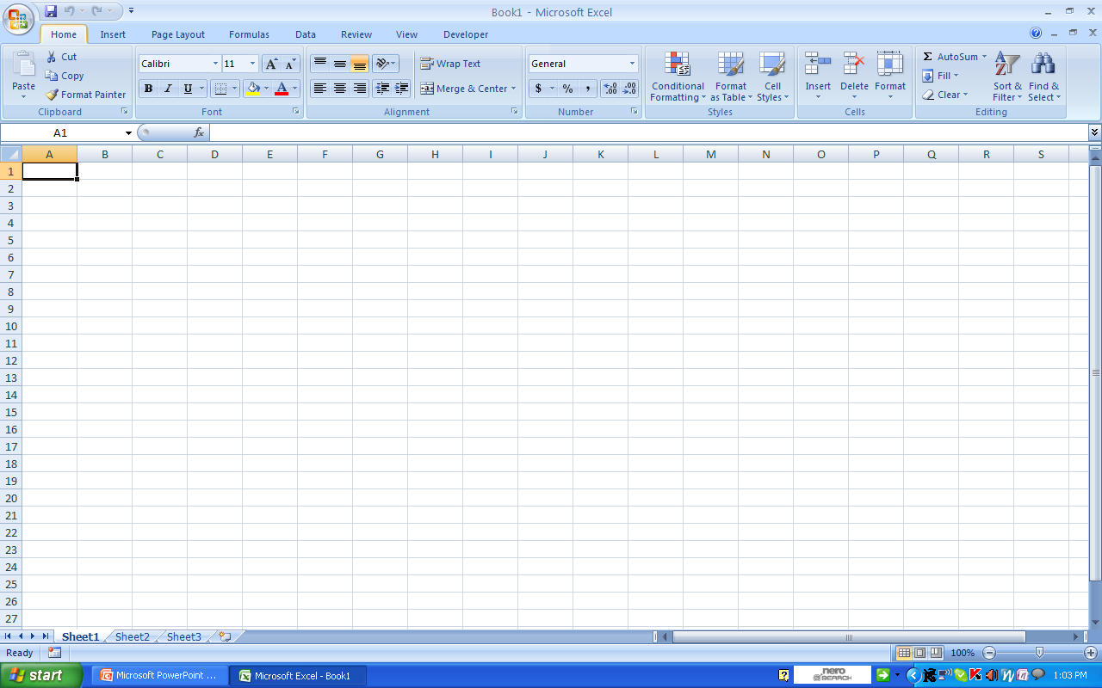
Navigating Through Excel – Exploring Menu Bar and Tool Bar Functions
Basic Options
Formatting and Editing options
To apply formatting to cells, depending on a certain condition
AutoSum, Sorting and Filtering options
Comments: Home tab provides the user a summary of all options

Slide 17
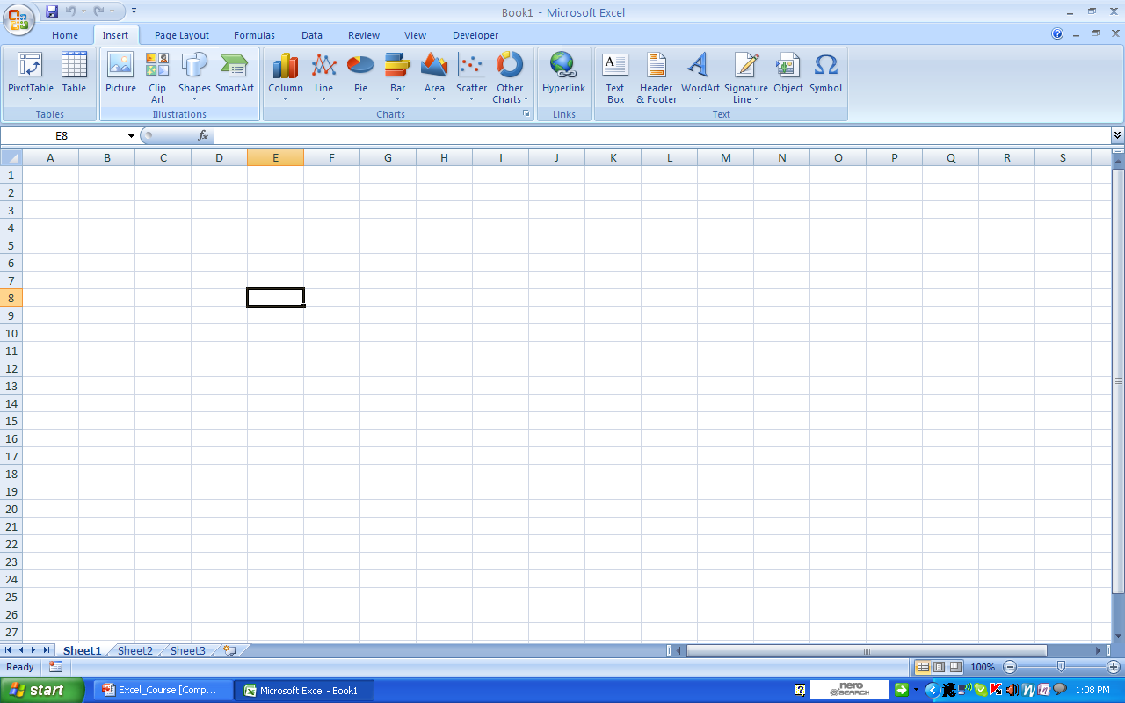
Navigating Through Excel – Exploring Menu Bar and Tool Bar Functions
Insert Options
Inserting different types of Charts
Creating Hyperlink
Applying Header and Footer
Inserting Tables and Pivot Tables
Comments: Insert tab holds some of the important and frequently used charts and pivot table options

Slide 18
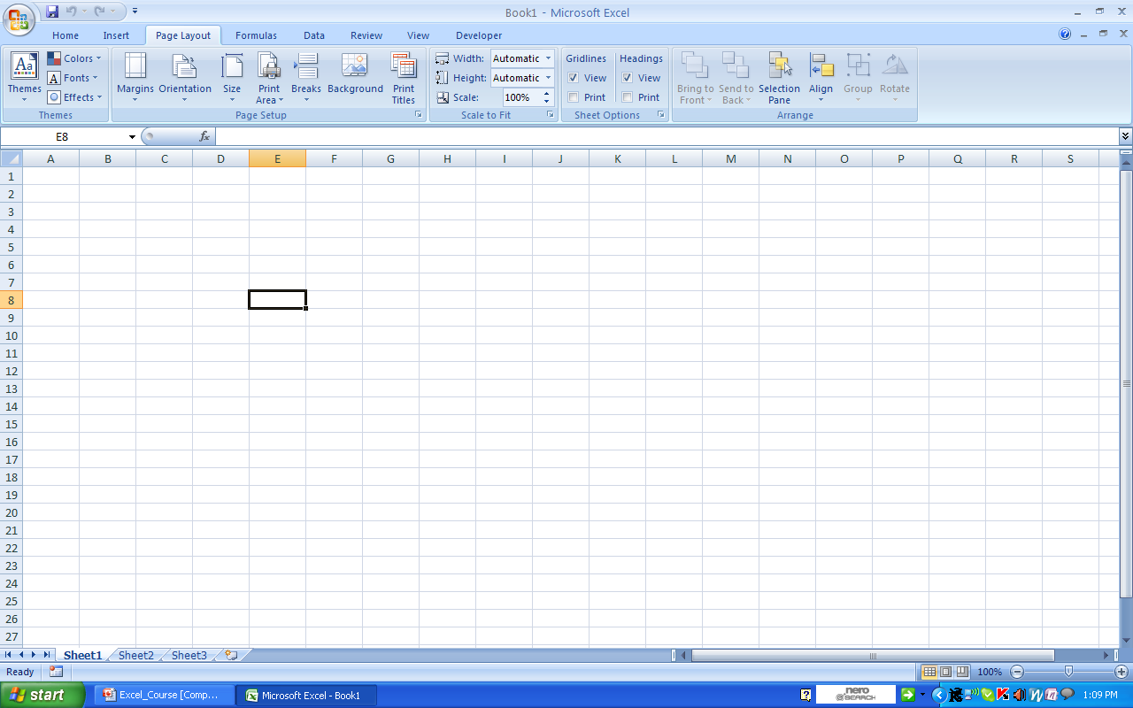
Navigating Through Excel – Exploring Menu Bar and Tool Bar Functions
Page Layout Options
Printing options used to setup page layout
Comments: Options used for printing, page setup and page break view are available on Page Layout tab

Slide 19
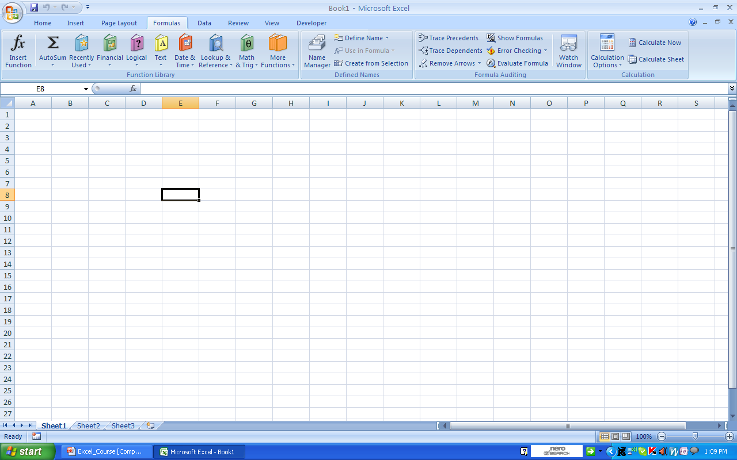
Navigating Through Excel – Exploring Menu Bar and Tool Bar Functions
Formula and Functions
Different types of Functions
Formatting and Auditing Formulae
Comments: It consists of all the available functions and formulae, that are applied on an Excel sheet

Slide 20

Navigating Through Excel – Exploring Menu Bar and Tool Bar Functions
Data Commands
Applying and Removing filters
Subtotals – for a data
Sorting a moderately sized dataset
Analyzing data with changing values
Grouping and Ungrouping data
Validation – Validating data and creating input boxes without using macros
Comments: Data tab consists of all the important data analysis, filtering and sorting options

Slide 21
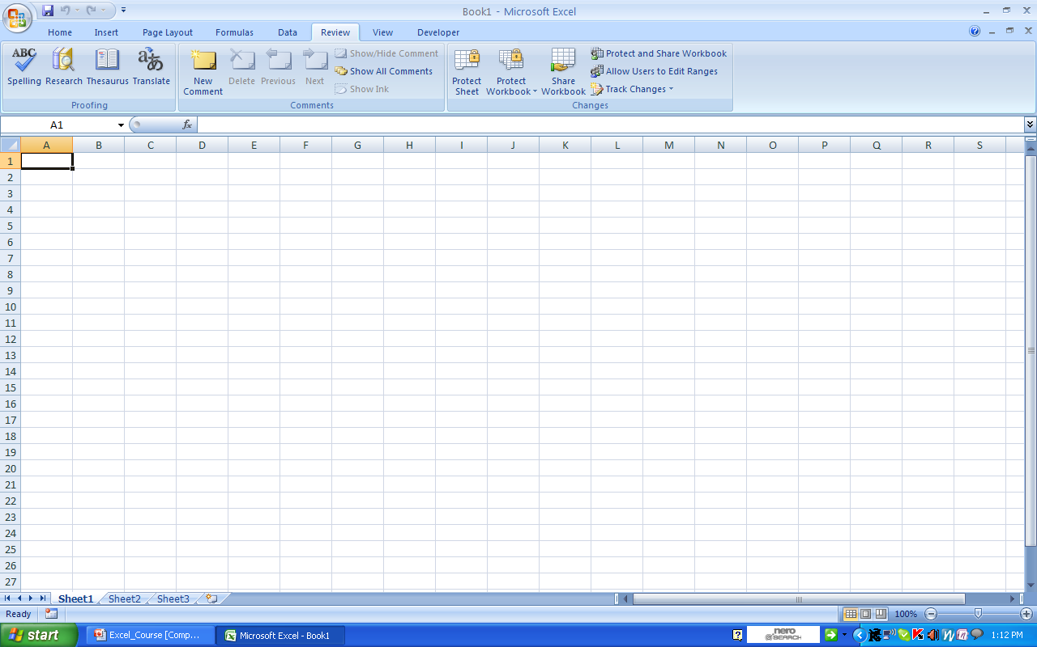
Navigating Through Excel – Exploring Menu Bar and Tool Bar Functions
Review Commands
Protecting and Sharing Workbook
Inserting and Viewing Comments
Comments: Workbook and worksheet security options are found on Review Tab

Slide 22

Navigating Through Excel – Exploring Menu Bar and Tool Bar Functions
View Commands
Macro options
View options of Worksheets
Freezing a Window Pane
Comments: Different ways of viewing a worksheets are available on View Tab. It includes viewing gridlines, page break view and zoom options. It also has an option to record maros.

Slide 23
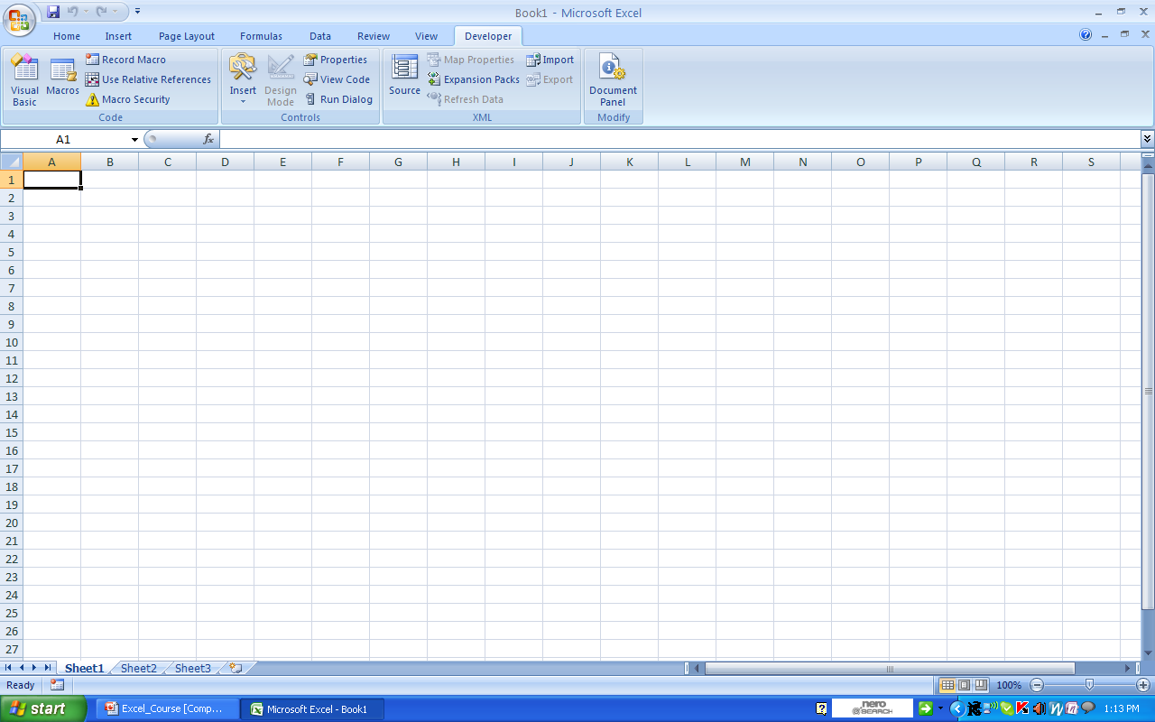
Navigating Through Excel – Exploring Menu Bar and Tool Bar Functions
Developer Commands
Form and ActiveX Controls
Visual Basic Editor
Comments: Macros, Security, Tool box and ActiveX Controls are available on Developer Tab

Slide 24
Advanced Features
Using Sorting and Filtering
  Open Credit bank file
  Sort on Credit card product
  Use filter to show only Gold and City Bangalore
  Remove Filter
  Create Subtotal based on credit card product on column Limit
Data Import from Text File
Hyperlink
Grouping and Using Subtotals
Using Advanced Filter
Removing Duplicates
Data Validation during data entry

Slide 25
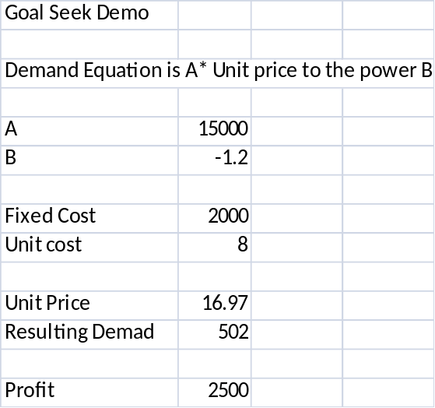
What if analysis - Goal Seek
Useful for solving equation for one unknown for better optimizations
Let us suppose that you want to optimize the company profit by manipulating the unit price
Use data ribbon – what if Analysis, Goal Seek
A model is created forecasting the demand with Constant parameters A B and unit price. We need to arrive at profit X by changing the unit price. The pre-requisites are Profit (set cell) should have formula, (To value) should be number desired to achieve, by changing (unit Price) should have a number not a formula.
Set to Profit Cell
To Value 2500
By changing Unit price cell
Profit formula = Unit price * demand – fixed cost – Unit cost*demand
Demand = A*Unit Price ^ B

Slide 26
Census Case Study
Create a report showing the list of villages with the Banking and Primary school facility
Report the list the villages, showing the density of population
Create a report showing the distribution of water resources. Also shortlist the top 10 villages with best and worst water resources/facilities

Slide 27
Printing Credit Banking file
Look at Office button print options
Explore print preview various options,
Adjust the margins
Goto page layout menu ribbon
Click on pageBreak view available near zoom level status bar
Use pagebreak . Selecting the print area, controlling the headers and footers
Explore
  the page setup options
  Scale to fit
  Sheet options
Explore the printer configuration options , no. of copies, collating sequence etc., range of pages to be printed, print what , properties tab of printer for double side printing or multiple page printing

Slide 28

Types of Function
Text
Statistical and Mathematical
Logical
Look up and Reference
Date and Time
Information
A function is entered in Cell giving ‘=<function Name> ‘ or press ƒx in formula bar (Shift F3) and select appropriate function and enter relevant function arguments – Explore Formula s ribbon

Slide 29
Census Case Study
Extract the prominent characters of Taluk code from the census data
  Right(code,2)
Extract 2 last but 2 characters from the village code
  Left(Right(code,4),2)
Find the village name with longest name
  Len(vill_name)
Create a new variable which will be combination of taluk code, block code and village code
  Concatenate(tal_code,B_code,Vill_Code)
  =tal_caode&” “&B_code&” “&Vill_code
Find a list of values which belong to a particular taluk

Slide 30

Types of Function – Text
Some examples to Text type of functions
Hygiene
  LEFT, RIGHT, TRIM
  FIND
  CONCATENATE, “&” Key
  LOWER, UPPER, PROPER
Expert
  LEN, EXACT
  SEARCH

Slide 31
Census Case Study
How many villages have POPHIGH – uses a function
  =Countif(PopulationMargin,”POPHIGH”)
Find the villages with maximum and minimum population
  =Max(T_P)
  =Min(T_P)
Find the sum of total population where the Banking facility is available – using a function
  =sumif(B_F,”=1”,T_P)

Slide 32
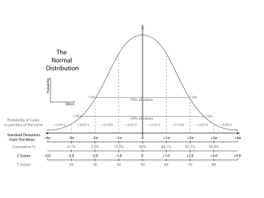
Types of Function – Statistical and Mathematical
Some examples to Formulae functions
Hygiene
  SUM, ROUND, AVERAGE, MAX, MIN
  SUMIF, COUNTIF
  MOD, SQRT
Expert
  SUMPRODUCT, MMULT, POWER
  CEILING, FLOOR, TRUNC
  RAND, RANDBETWEEN, EXP, PRODUCT

Slide 33
Census Case Study
Create a variable called PopulationMargin which will holds the following values based on the population values
  Population greater then average population – POPHIGH
  Population lesser then average population – POPLOW
    =if(T_P>average(T_P),”POPHIGH”, “POPLOW”)
How many villages have POPHIGH – uses a function
  =Countif(PopulationMargin,”=POPHIGH”)
Where ever female population is less than 1000, replace it with average female population
  =IF(F_P<1000,average(F_P),” “)

Slide 34

Types of Function – Logical
Some examples to Logical functions
Expert
  AND gives true or false Ex.=AND(A1>5,A2>5)
  OR gives true or False =OR(0,0) is False
  IF(Logical condition, Value if True, Value if False)

Slide 35
Census Case Study
Extract the values from the Data Dictionary for the header codes in the Data sheet and display the same in a row beneath the header code in Data sheet
  Using Vlookup
Create a new database with the following variables from the two datasets: Census_1 and Census_2
  Total Population
  Primary Education
  Banking Facility
  Hospitals and Dispensaries
    Using Vlookup and Hlookup

Slide 36

Types of Function – Look up and Reference
Some examples to Reference functions
Hygiene
  VLOOKUP, HLOOKUP, LOOKUP
  INDEX, MATCH
Expert
  INDIRECT, OFFSET

Slide 37
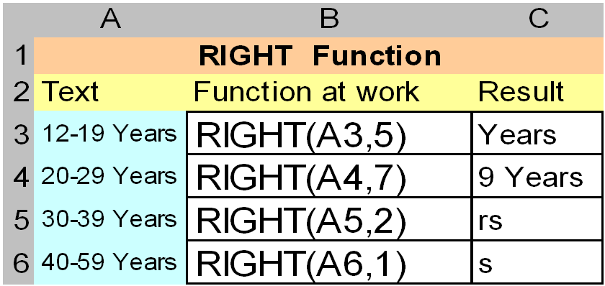

Syntax – RIGHT(text,num_chars)
Text – the text string that contains the characters you want to extract
Num_chars – specifies the number of characters you want RIGHT to extract

Slide 38
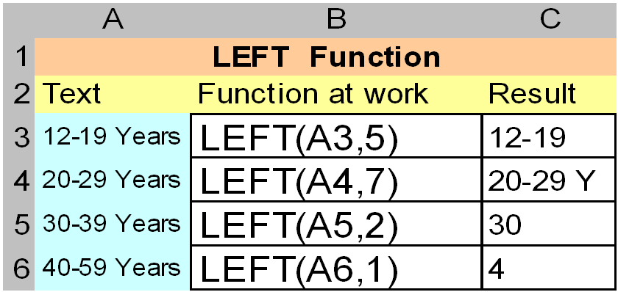
Syntax – LEFT(text,num_chars)
Text – the text string that contains the characters you want to extract
Num_chars – specifies the number of characters you want LEFT to extract

Slide 39
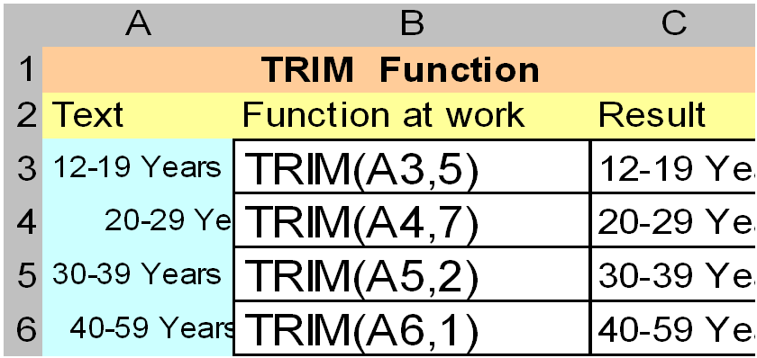
Syntax – TRIM(text)
Text – the text string that contains the characters you want to extract

Slide 40
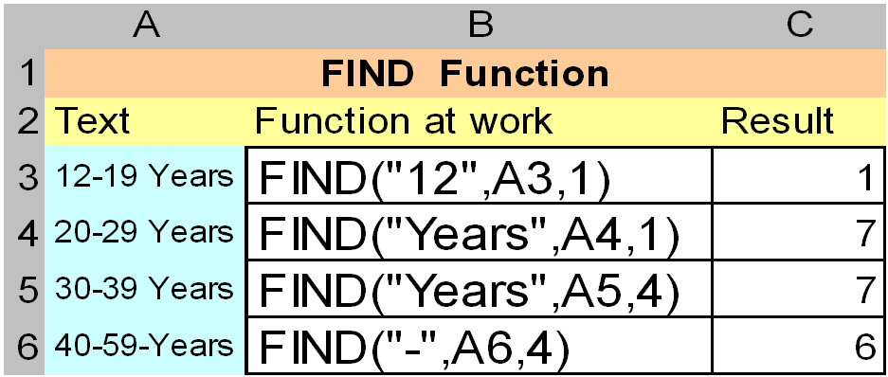
Syntax – FIND(find_text,within_text,start_num)
Find_text – the text you want to find
Within_text – the text containing the text you want to find
Start_num – specifies the character at which to start the search. The first character in within_text is character number 1. If you omit start_num, it is assumed to be 1

Slide 41
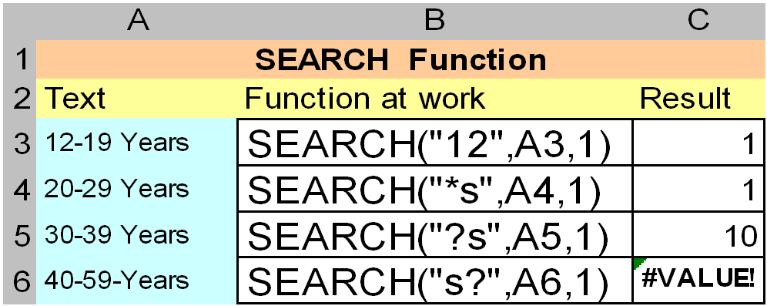
Syntax – SEARCH(find_text,within_text,start_num)
Find text – the text you want to find. You can use the wildcard characters, question mark (?) and asterisk (*), in find text. A question mark matches any single character; an asterisk matches any sequence of characters. If you want to find an actual question mark or asterisk, type a tilde (~) before the character
Within text – the text in which you want to search for find text
Start num – the character number in within text at which you want to start searching
What is the difference between Find and Search

Slide 42
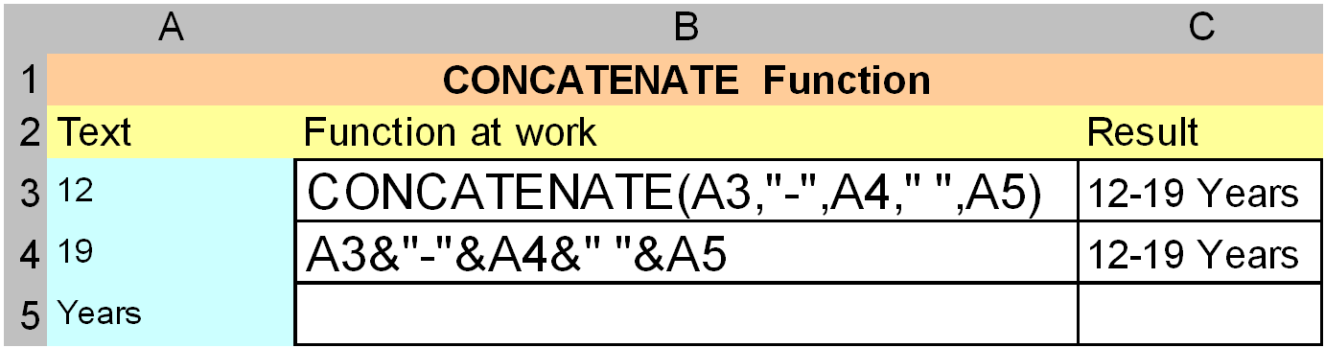
Syntax – CONCATENATE(text1,text2,...)
Syntax – text1&text2&text3&…..
text1, text2, ... – are 1 to 30 text items to be joined into a single text item. The text items can be text strings, numbers, or single-cell references

Slide 43
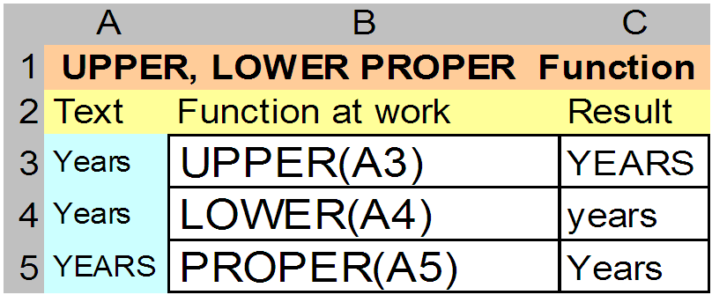
Syntax – UPPER(Text)
Syntax – LOWER(Text)
Syntax – PROPER(Text)
Text – the text you want to convert to uppercase, lowercase and propercase respectively. These functions does not change characters in text that are not letters

Slide 44
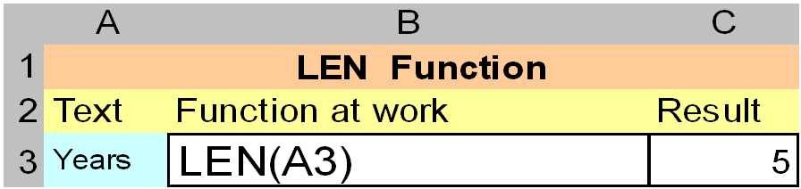
Syntax – LEN(Text)
Text – the text whose length you want to find. Spaces count as characters

Slide 45
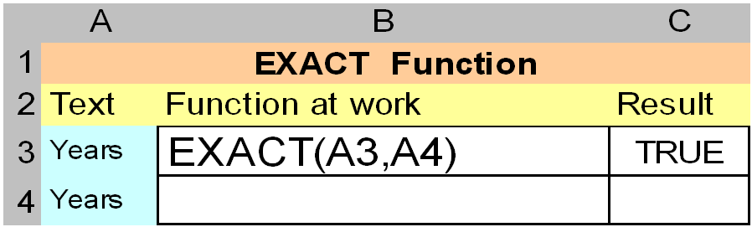
Syntax – EXACT(text1,text2)
Text1 – is the first text string
Text2 – is the second text string

Slide 46
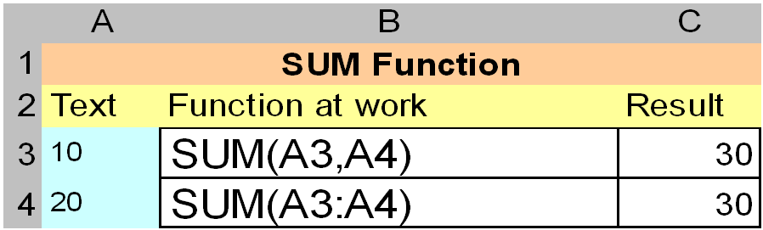
Syntax – SUM(number1,number2, ...)
Number1, number2, ... – are 1 to 30 arguments for which you want the total value or sum

Slide 47
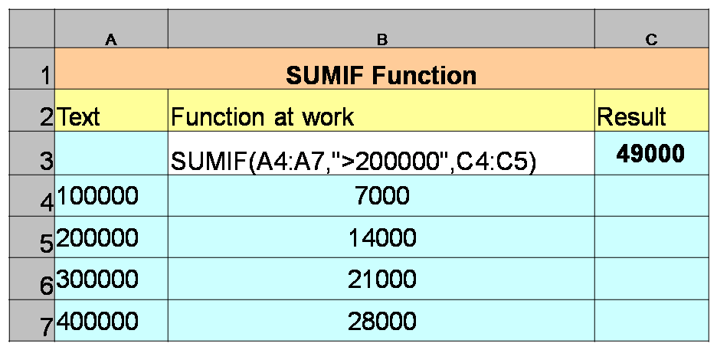
Syntax – SUMIF(range,criteria,sum_range)
Range – is the range of cells you want evaluated
Criteria – is the criteria in the form of a number, expression, or text that defines which cells will be added
Sum range – are the actual cells to sum

Slide 48
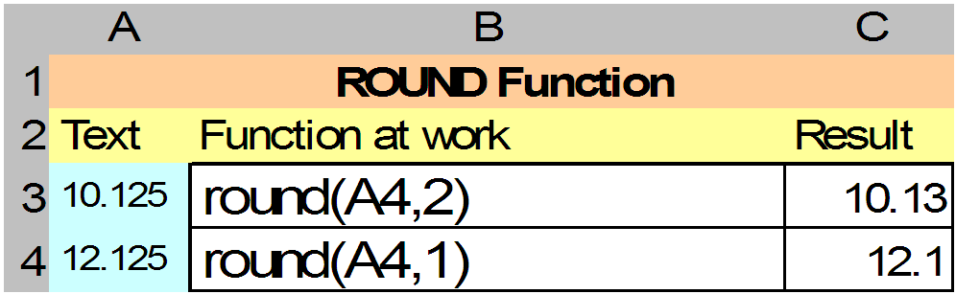
Syntax – ROUND(number,num_digits)
Number – is the number you want to round
Num digits – specifies the number of digits to which you want to round number

Slide 49
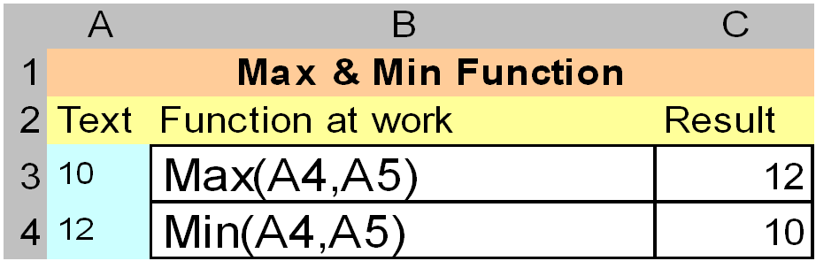
Syntax – MAX(number1,number2,...)
Syntax – MIN(number1,number2,...)
Number1, number2, ... – are 1 to 30 numbers for which you want to find the maximum and minimum value

Slide 50
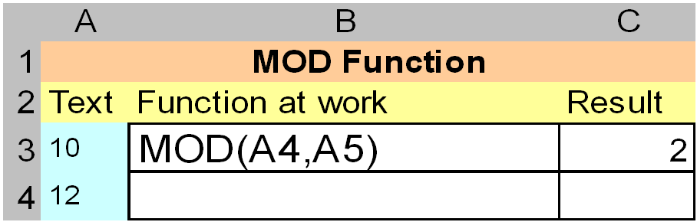
Syntax – MOD(number,divisor)
Number – is the number for which you want to find the remainder
Divisor – is the number by which you want to divide number

Slide 51
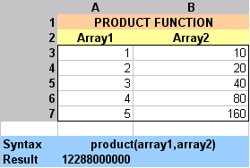
Syntax – PRODUCT(number1,number2,...)
Number1, number2, ... – are 1 to 30 numbers that you want to multiply

Slide 52
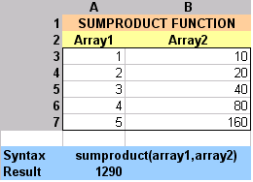
Syntax – SUMPRODUCT(array1,array2,array3,...)
Array1, array2, array3, ... – are 2 to 30 arrays whose components you want to multiply and then add

Slide 53
Syntax – MMULTI (array1,array2) – Matrix Multiplication
Array1 “m X n” matrix , array2 should be “n X O” the result will be “m X O” matrix. The rows of array1 should be matching with columns of array2
Array1- 2 X 2
Array2- 2 X 2
Working
Result is 2 X 2
3 | 0
3 | 1
X
2 | 1
0 | 2
=
3x2+0*0 | 3x1+0*2
3x2+1*0 | 3x1+1x2
=
6 | 3
6 | 5
When you declare the formula in a cell =mmult(array1,array2) you get the result 6 only . To get the complete matrix , you need to select 4 cells , Press F2 to edit and press CRTL+SHIFT+ENTER .

Slide 54
  POWER(number, power) to get the number to the power
    POWER(5,2) Calculates five squared (25) , 5^3 Calculates five cubed (125)
  CEILING (number, significance) rounds up to the nearest integer / significance. Opposite is FLOOR(number, significance) , TRUNC(number, numdigits) -Rounds number down, toward zero, to the nearest multiple of significance
    CEILING(2.5, 1) Rounds 2.5 up to nearest multiple of 1 (3)
    CEILING(-2.5, -2) Rounds -2.5 up to nearest multiple of -2 (-4)
    CEILING(-2.5, 2) Returns an error, because -2.5 and 2 have different signs (#NUM!)
    CEILING(1.5, 0.1) Rounds 1.5 up to the nearest multiple of 0.1 (1.5)
    CEILING(0.234, 0.01) Rounds 0.234 up to the nearest multiple of 0.01 (0.24)
  RAND() generates fractional number between 0 to 1 whereas
  RANDBETWEEN(Bottom, top) generates between bottom
  and top numbers

Slide 55
  EXP(number) - Returns e raised to the power of number. The constant e equals 2.71828182845904, the base of the natural logarithm. Exp(2) – 7.38
  PRODUCT(number1,number2, …) multiplies all the numbers given
Other functions of statistical, information
  MEAN, STD,
  ISBLANK,ISEVEN()

Slide 56
Syntax – VLOOKUP(lookup_value,table_array,col_index_num,range_lookup)
Searches for a value in the leftmost column of a table, and then returns a value in the same row from a column you specify in the table. Use VLOOKUP instead of HLOOKUP when your comparison values are located in a column to the left of the data you want to find
  Lookup_value – is the value to be found in the first column of the array. Lookup_value can be a value, a reference, or a text string
  Table_array – is the table of information in which data is looked up
  Col_index_num – is the column number in table_array from which the matching value must be returned. A col_index_num of 1 returns the value in the first column in table_array; a col_index_num of 2 returns the value in the second column in table_array, and so on. If col_index_num is less than 1, VLOOKUP returns the #VALUE! error value; if col_index_num is greater than the number of columns in table_array, VLOOKUP returns the #REF! error value
  Range_lookup – is a logical value that specifies whether you want VLOOKUP to find an exact match or an approximate match. If TRUE or omitted, an approximate match is returned. In other words, if an exact match is not found, the next largest value that is less than lookup value is returned. If FALSE, VLOOKUP will find an exact match. If one is not found, the error value #N/A
  is returned

Slide 57
Syntax – VLOOKUP(lookup_value,table_array,col_index_num,range_lookup)
Number of Licenses | Discount
1 | 0% | Cost of Each License | 2000
5 | 5% | Number of Licenses | 6
10 | 7% | Discount Band | 5
15 | 10% | Applicable Discount | 0.05
20 | 12% | Your bill | 11400
25 | 15%

Slide 58
Syntax – HLOOKUP(lookup_value,table_array,row_index_num,range_lookup)
Searches for a value in the top row of a table or an array of values, and then returns a value in the same column from a row you specify in the table or array. Use HLOOKUP when your comparison values are located in a row across the top of a table of data, and you want to look down a specified number of rows. Use VLOOKUP when your comparison values are located in a column to the left of the data you want to find
  Lookup_value – is the value to be found in the first row of the table. Lookup_value can be a value, a reference, or a text string
  Table_array – is a table of information in which data is looked up. Use a reference to a range or a range name
  Row_index_num – is the row number in table_array from which the matching value will be returned. A row_index_num of 1 returns the first row value in table_array, a row_index_num of 2 returns the second row value in table_array, and so on. If row_index_num is less than 1, HLOOKUP returns the #VALUE! error value; if row_index_num is greater than the number of rows on table_array, HLOOKUP returns the #REF! error value
  Range_lookup – is a logical value that specifies whether you want HLOOKUP to find an exact match or an approximate match. If TRUE or omitted, an approximate match is returned. In other words, if an exact match is not found, the next largest value that is less than lookup_value is returned. If FALSE, HLOOKUP will find an exact match. If one is not found, the error value #N/A
  is returned
Similar to Vlookup except columns are inverted to rows

Slide 59
Syntax – INDEX(array,row_num,column_num)
Returns a value or the reference to a value from within a table or range
  Array – is a range of cells or an array constant
  Row_num – selects the row in array from which to return a value. If row_num is omitted, column_num is required
  Column_num – selects the column in array from which to return a value. If column_num is omitted, row_num is required
  Ex. =Index(A1:B2,2,2) gives Pears
Apples | Lemons
Bananas | Pears
Syntax – MATCH(lookup_value,lookup_array,match_type)
Returns the relative position of an item in an array that matches a specified value in a specified order
  Lookup_value – is the value you use to find the value you want in a table
  Lookup_array – is a contiguous range of cells containing possible lookup values
  Match_type – is the number -1 descending order sort,. For 0, or 1 Ascending order sort
Product | Count
Bananas | 25
Oranges | 38
Apples | 40
Pears | 41
Match(38,array,0) gives position 2,

Slide 60
Syntax – IF(logical_test,value_if_true,value_if_false)
Returns one value if a condition you specify evaluates to TRUE and another value if it evaluates
to FALSE
  Logical_test – is any value or expression that can be evaluated to TRUE or FALSE. For example, A10=100 is a logical expression; if the value in cell A10 is equal to 100, the expression evaluates to TRUE. Otherwise, the expression evaluates to FALSE. This argument can use any comparison calculation operator
  Value_if_true – is the value that is returned if logical_test is TRUE. For example, if this argument is the text string "Within budget" and the logical_test argument evaluates to TRUE, then the IF function displays the text "Within budget". If logical_test is TRUE and value_if_true is blank, this argument returns 0 (zero). To display the word TRUE, use the logical value TRUE for this argument. Value_if_true can be another formula
  Value_if_false – is the value that is returned if logical_test is FALSE. For example, if this argument is the text string "Over budget" and the logical_test argument evaluates to FALSE, then the IF function displays the text "Over budget". If logical_test is FALSE and value_if_false is omitted, (that is, after value_if_true, there is no comma), then the logical value FALSE is returned. If logical_test is FALSE and value_if_false is blank (that is, after value_if_true, there is a comma followed by the closing parenthesis), then the value 0 (zero) is returned. Value_if_false can be another formula
Ex. A1 value is 10 put formula in A2=if(A1>5,”Greater than 5”,”False”)
You get the value Greater than 5 in A2
Create two columns with similar data with differences and find out how many differences are there ?

Slide 61
Syntax – AND(logical1,logical2, ...)
Returns TRUE if all its arguments are TRUE; returns FALSE if one or more argument is FALSE
  Logical1, logical2, ... – are 1 to 30 conditions you want to test that can be either TRUE or FALSE
Syntax – OR(logical1,logical2,...)
Returns TRUE if any argument is TRUE; returns FALSE if all arguments are FALSE
  Logical1, logical2, ... – are 1 to 30 conditions you want to test that can be either TRUE or FALSE

Slide 62


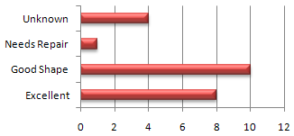
Types of Charts and Formatting
Creating a chart
Select the data cells
Select Insert ribbon
Click on charts - a) Column charts
        b) Bar charts,
        c) line charts
        d) Pie charts
        e) Scatter Plot

Slide 63
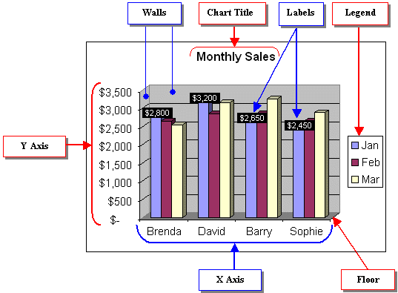

Slide 64
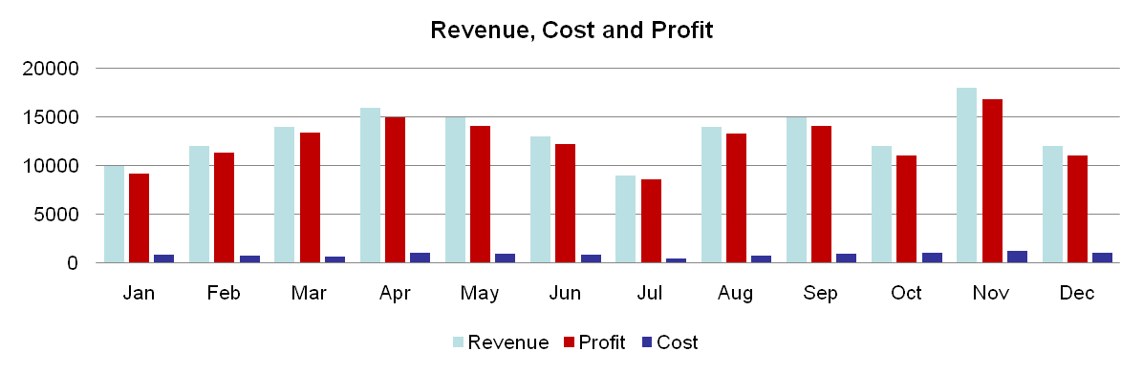
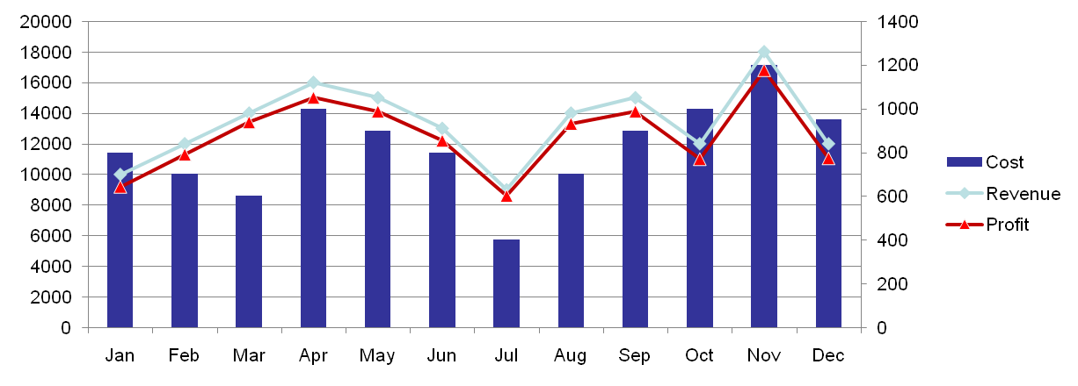
Types of Charts and Formatting
How do you Add Secondary Axis ?

Slide 65
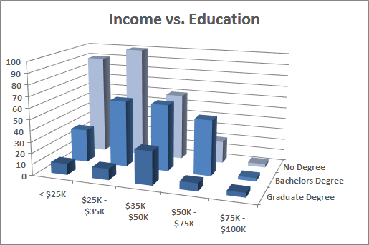
Pivot Tables
Pivot Table
Summary Report generated from a database
Dataset can reside in a worksheet or in an external data file
Display subtotals and any level of detail that you want
Pivot table does not update automatically when you change the source

Slide 66
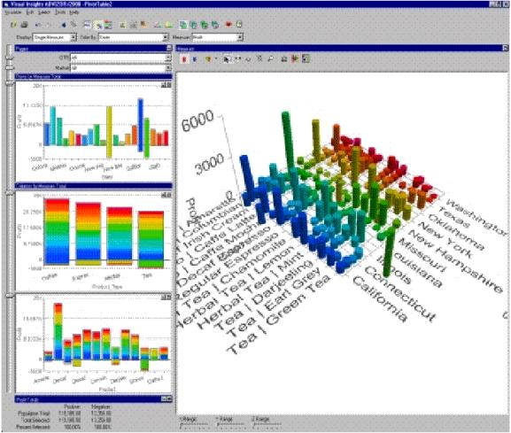
Creating a Pivot Table
Specify the Data location
Select the data
Complete the Pivot table

Slide 67
Microsoft Excel List or Database
Usually, the data that you analyze is stored in a worksheet database (also known as a list). Databases stored in a worksheet have a limit of 65,535 records and 256 fields. The first row in the database should contain field names. No other rules exist. The data can consist of values, text, or formulas
External Data Source
If you use the data in an external database for a pivot table, use Query (a separate application) to retrieve the data. You can use dBase files, SQL Server data, or other data that your system is set up to access
Multiple Consolidation Ranges
You also can create a pivot table from multiple tables. This procedure is equivalent to consolidating the information in tables. When you create a pivot table to consolidate information in tables, you have the added advantage of using all of the pivot table tools while working with the consolidated data
Another Pivot Table Report or Pivot Chart Report
Excel enables you to create a pivot table from an existing pivot table or pivot chart. Actually, this is a bit of a misnomer. The pivot table that you create is based on the data that the first pivot table uses (not the pivot table itself). If the active workbook has no pivot tables, this option is grayed—meaning you can’t choose it. If you need to create more than one pivot table from the same set of data, the procedure is more efficient (in terms of memory usage) if you create the first pivot table and then use that pivot table as the source for subsequent pivot tables

Slide 68
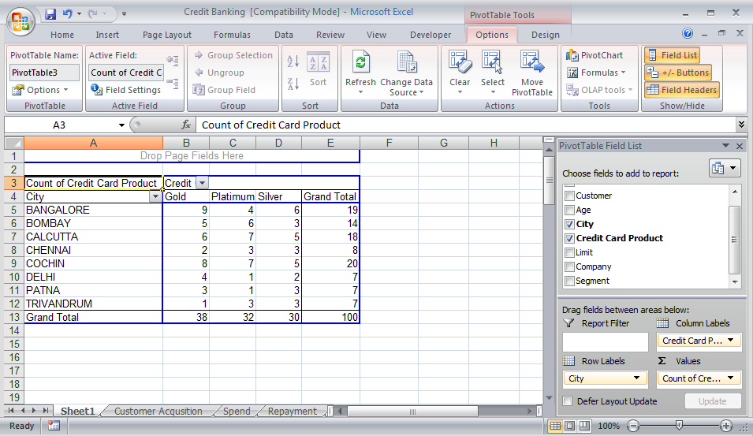
Page filter

Slide 69

Thank You

